Slide 1

Voice-Controlled ESP32 Switch Board with ​
Alexa/Google Home Integration​
Supervisor: Prof. Israj Ali
Group No. - 118 Aakarshan Shaurya 2004211
Amritanshu Apurva 2004213
Vikash Kumar 2004247
Waatsal Srivastava 2004266

Slide 2
01
Problems without Smart Switchboard
Lack of Convenience
02
Difficult to Customize
03
Energy Wastage

Slide 3
1
Convenience
Voice-control easy way to control
4
Personalization
Demand
Trigger specific actions based on unique commands
2
Integration
Alexa or Google Home
5
Energy Efficiency
automated time to turn off light like scheduling things
3
Cost-effectiveness
Due to make affordable for everyone

Slide 4
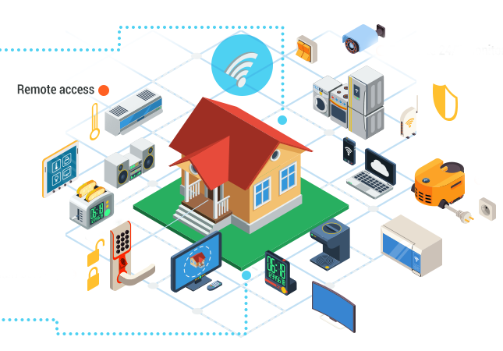
Example of Demand of IoT

Slide 5
Recent Development
Smart Lighting
Smart fans
Such as Philips Hue and LIFX, can be controlled remotely and offer features such as dimming and color changing.
These fans are designed to be more energy-efficient and convenient than traditional ceiling fans.
Smart thermostats
Smart Plug
It is designed to be plugged into an electrical outlet, and then you plug your appliance into the smart plug.
such as Nest and Ecobee, are becoming more popular as they offer improved energy efficiency and ease of use.

Slide 6

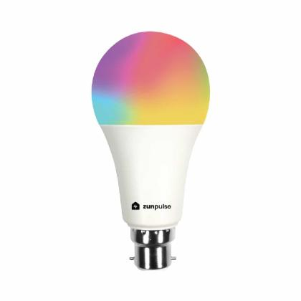
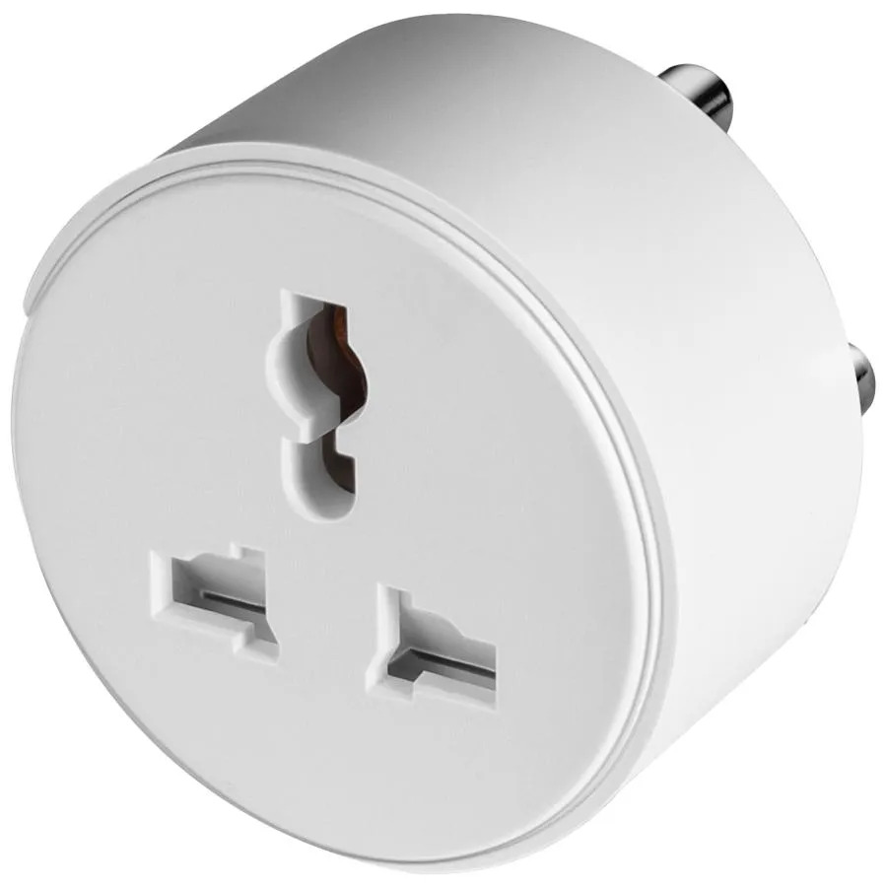
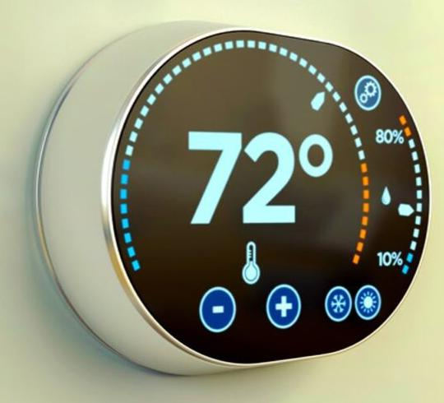
Some Examples of Recent Development

Slide 7
Problems in Recent Development
Cost
Accessibility
Connectivity
User Interface
The Cost of the smart Devices is to high and unaffordable for some peoples
Its problem in new devics of some people due to not user friendly (exp old age peoples)
It's totally depends on internet supposed without internet this devices may not work properly
User interface is also not friendally
For everyone

Slide 8
Benefits of our project
Cost Effective
Easy User Interface
Because New Smart Devices price are to high
So Everyone can used like child and adult
Easy Accessibility
To convert Old Traditional Components to Smart Components
Make Easy Accessible for Every type of peoples
It can be installed without replacing old traditional switchboard.
Better Connectivity
Internet & without Internet Support

Slide 9
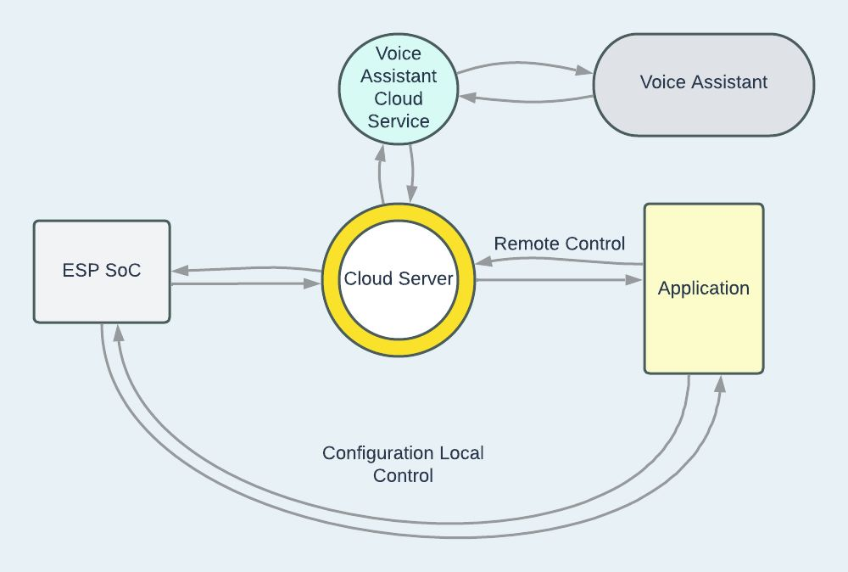
Flow Chart

Slide 10

The Server
1
Ease of Maintenance
2
Cost Effective
3
Private Development
4
Voice Assistant Integration
Neptune
Neptune is the farthest from the Sun

Slide 11
The Server
Simplifies the process of developing and deploying IoT solutions.
It supports a wide range of sensors and actuators.
Server provides enhanced security.
A cloud-based IoT platform.
The AWS powered server is highly scalable.

Slide 12
Conclusion
In conclusion, a voice-controlled smart home automation system can provide many benefits, including convenience, energy efficiency, and enhanced security. The system allows users to control their home devices using their voice, making it an accessible and user-friendly technology without replacing old traditional switchboards. However, there are also important considerations, such as cost, data privacy, and security, that must be addressed to ensure that the technology is accessible and safe for all users. Additionally, advancements in AI technology and the integration with other smart home devices and platforms offer exciting opportunities to level up the system and create a more advanced, user-friendly, and intelligent system.

Slide 13
Thank You

